Slide 1
Micro Credit Loan Defaulter
Flip Robo Technologies
Rahul S Sharma

Slide 2
Problem Definition
A Microfinance Institution (MFI) is an organization that offers financial services to low income populations. MFS becomes very useful when targeting especially the unbanked poor families living in remote areas with not much sources of income. The Microfinance services (MFS) provided by MFI are Group Loans, Agricultural Loans, Individual Business Loans and so on.
They are collaborating with an MFI to provide micro-credit on mobile balances to be paid back in 5 days. The Consumer is believed to be defaulter if he deviates from the path of paying back the loaned amount within the time duration of 5 days. For the loan amount of 5 (in Indonesian Rupiah), payback amount should be 6 (in Indonesian Rupiah), while, for the loan amount of 10 (in Indonesian Rupiah), the payback amount should be 12 (in Indonesian Rupiah).
Build a model which can be used to predict in terms of a probability for each loan transaction, whether the customer will be paying back the loaned amount within 5 days of insurance of loan. In this case, Label ‘1’ indicates that the loan has been payed i.e. Non- defaulter, while, Label ‘0’ indicates that the loan has not been payed i.e. defaulter.

Slide 3
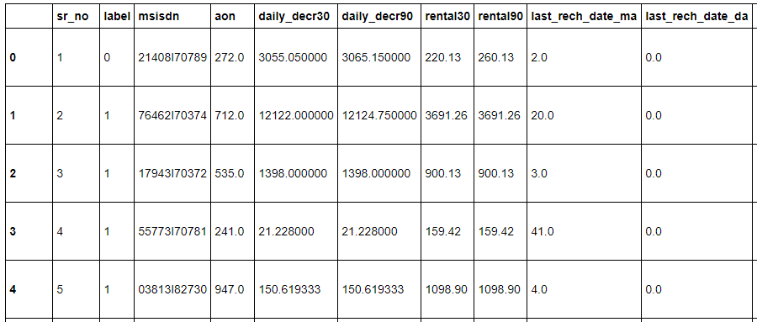
Data Feature and Analysis
We have import the dataset to Jupyter notebook using pandas library.

Slide 4
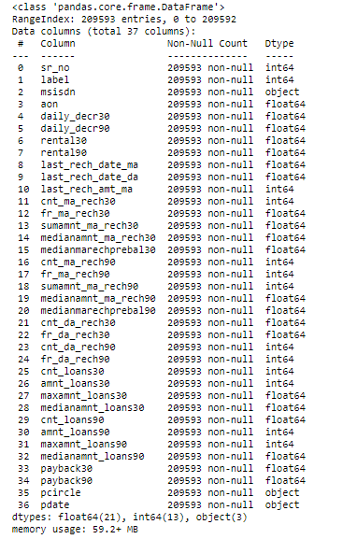
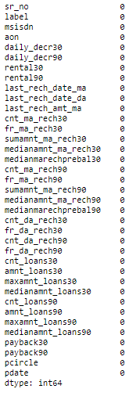
Datatypes of dataset: we use info command to display all Null Values: We use df.isnull().sum() to check the null values in the dataset the description of dataset. It contain 209593 rows and 37 column. and it has no null values. Label column is our target variable. It has 21 float type columns, 3 object type columns, 13 int type columns. The memory occupied is 59.2MB.

Slide 5
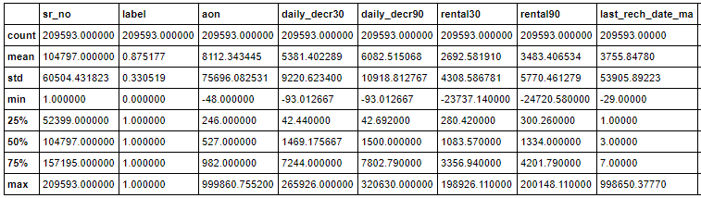
Statistical summary: We use df.describe() method to see the statistical summary of the dataset. It allows us to see the mean, median, count, standard deviation, minimum, maximum, percentile values of all numeric columns. From the summary we can see that some of the column contains negative values which can be outliers. So we need to treat them. In some columns the mean is greater than the median. So data is right skewed. We need to normalize the data.

Slide 6
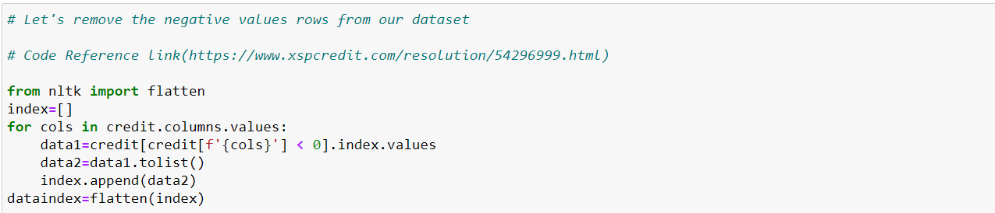
We drop unnecessary columns like “sr_no.” , “msisdn” as they contain all the unique values which does not contribute in the analysis of dataset. We also drop “pcircle” column as it contain single unique value. So it is not helpful in our analysis. We have also removed the negative values from dataset as percentage loss was 3% which is in the range of 8%. The code is shown below.

Slide 7
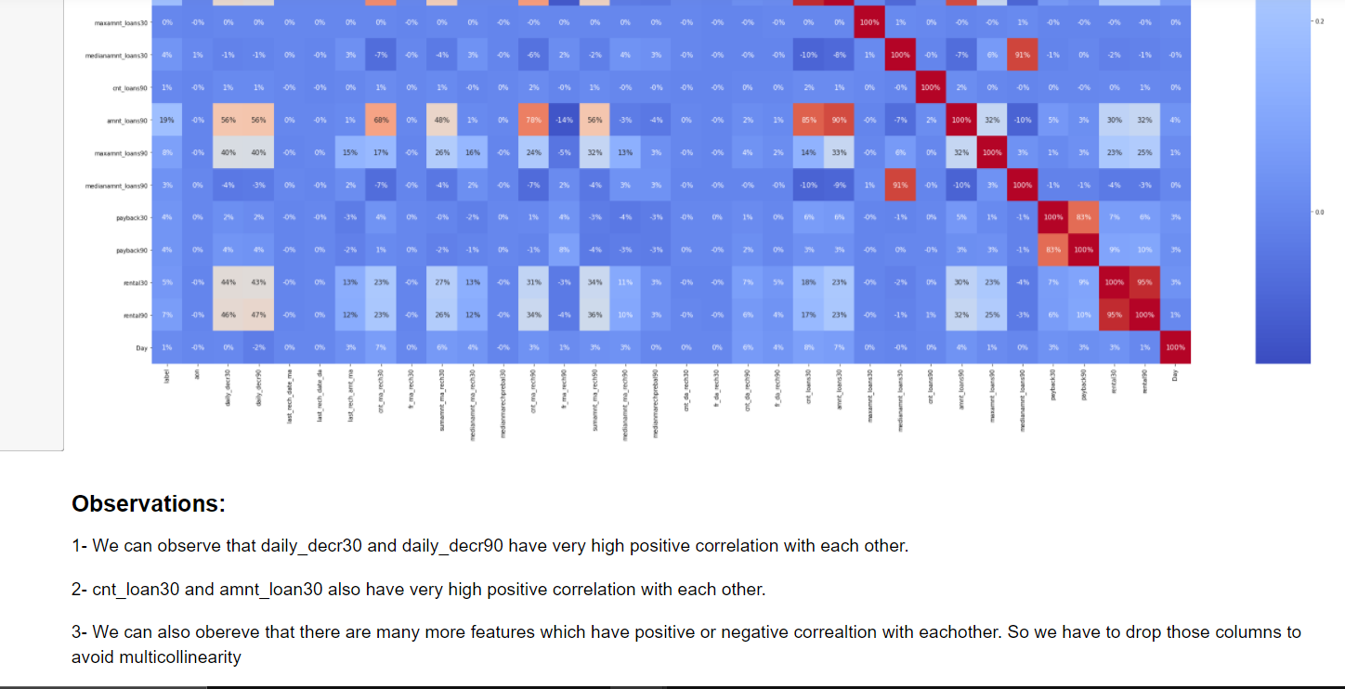
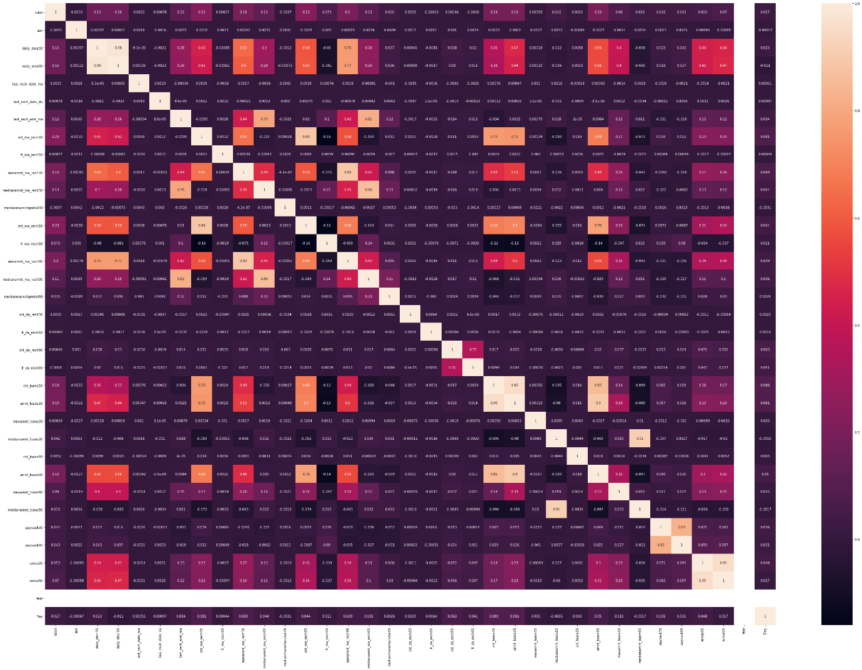
Correlation:

Slide 8
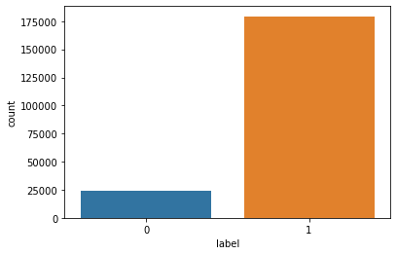
Data Visualization:
We have two libraries for the visualization purpose of the dataset namely Matplotlib.pyplot as plt and seaborn as sns. We have visualozed the data usinf countplots, barplots, histograms, distplots,etc.
The plot shows that the data is imbalances and the defaulter rate is less than non - defaulter.

Slide 9
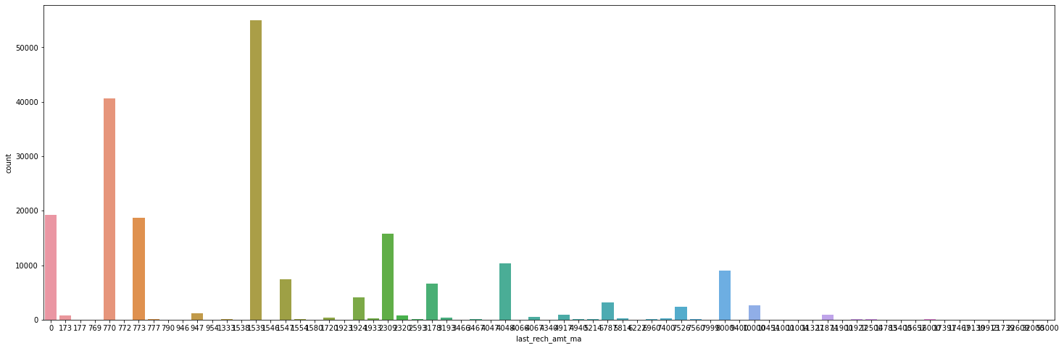
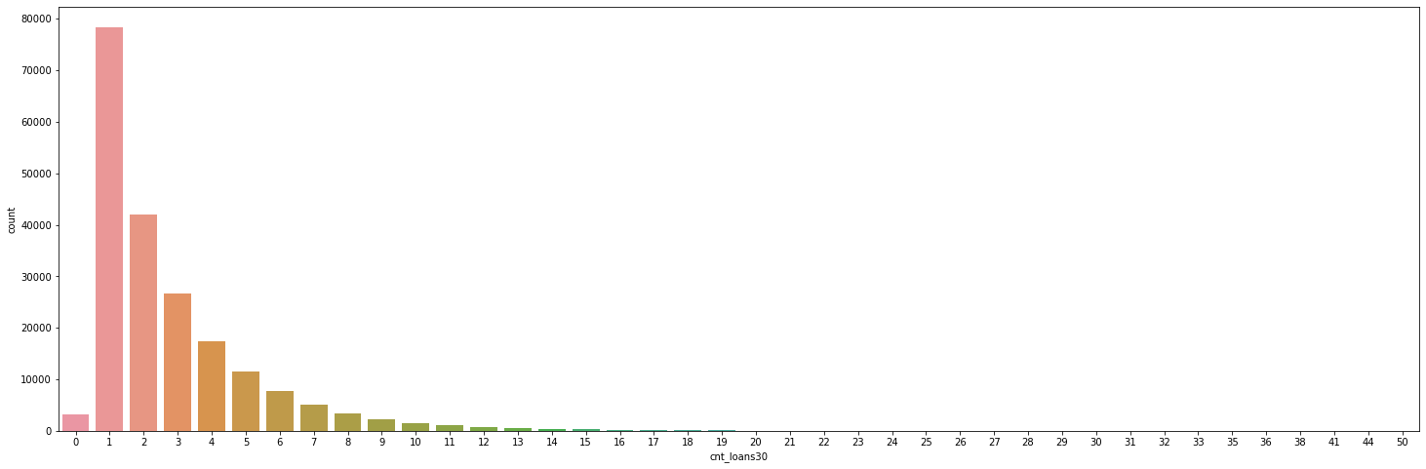
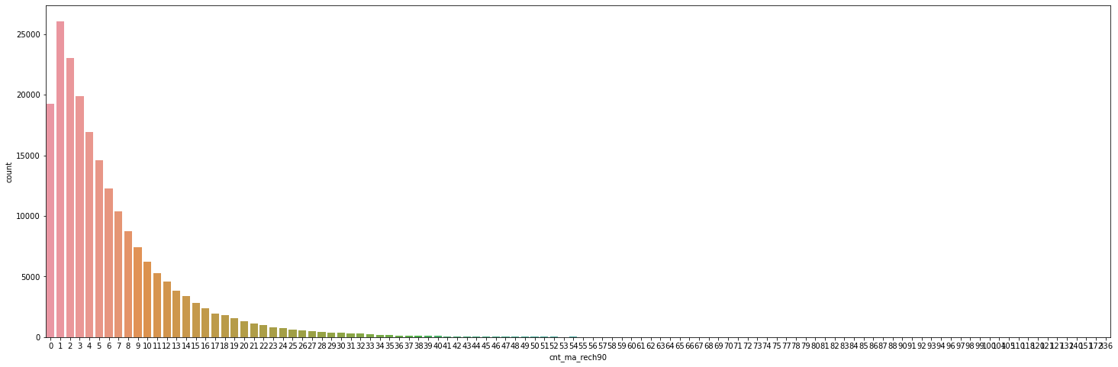
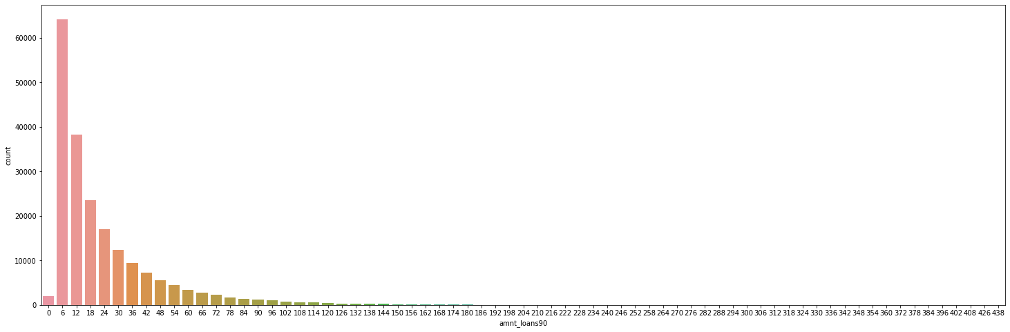
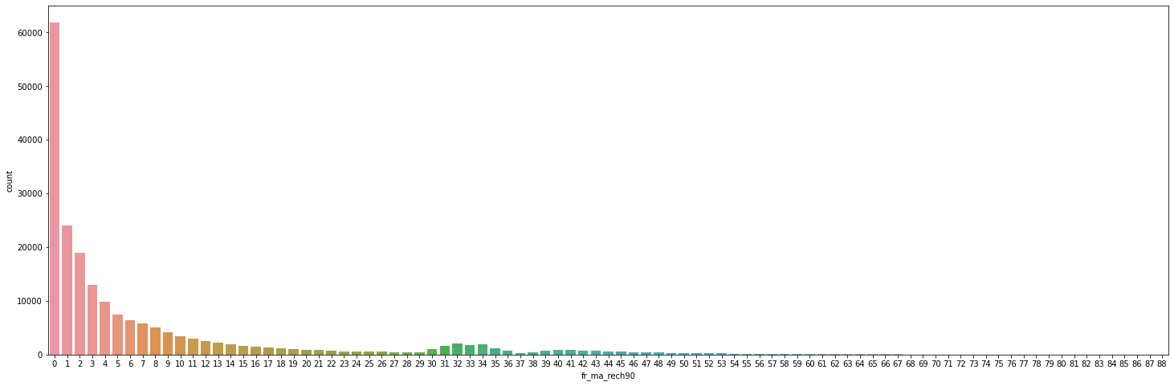
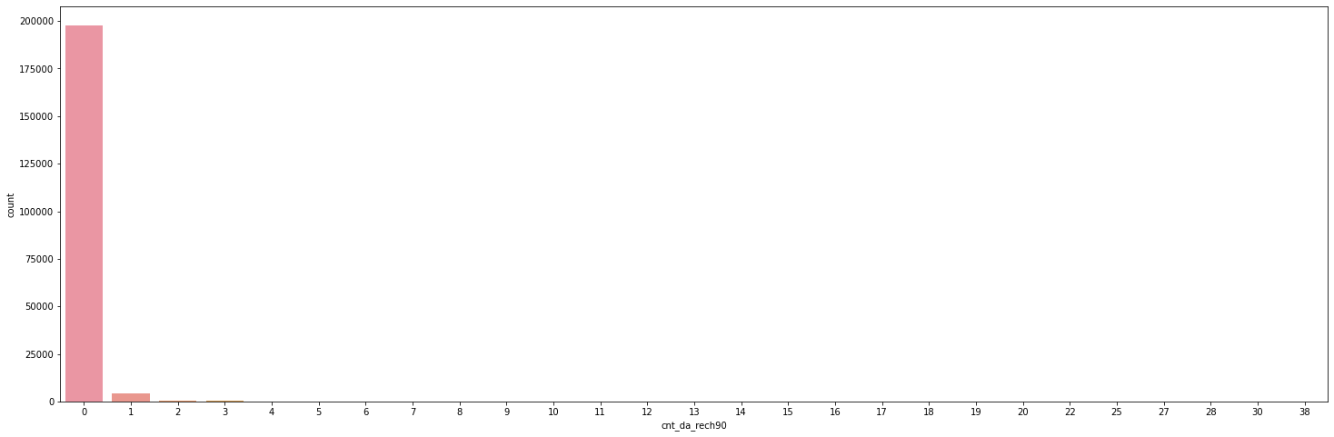
Count plots for various features

Slide 10
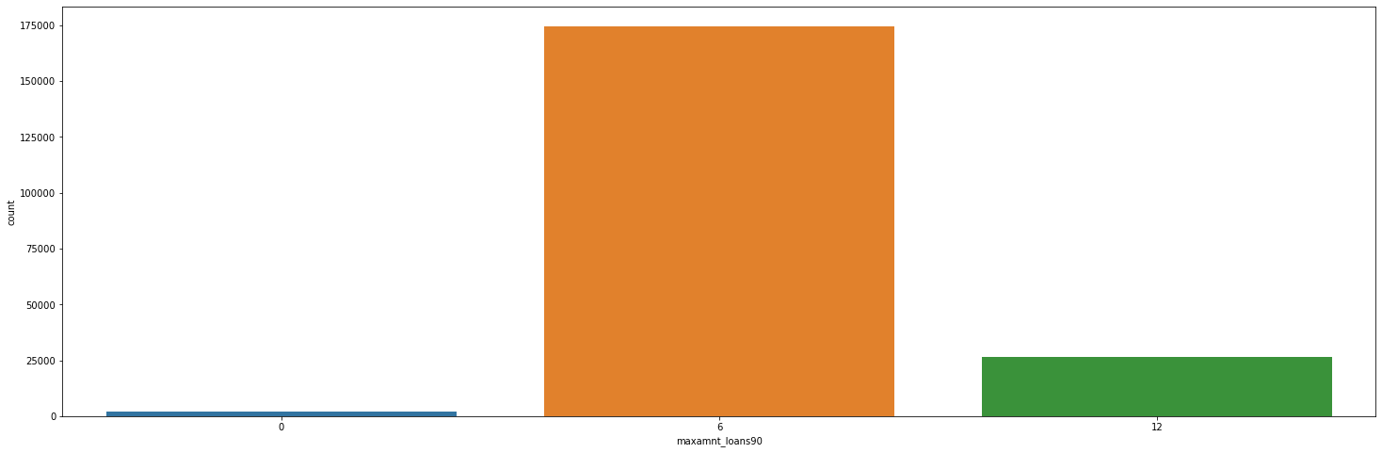
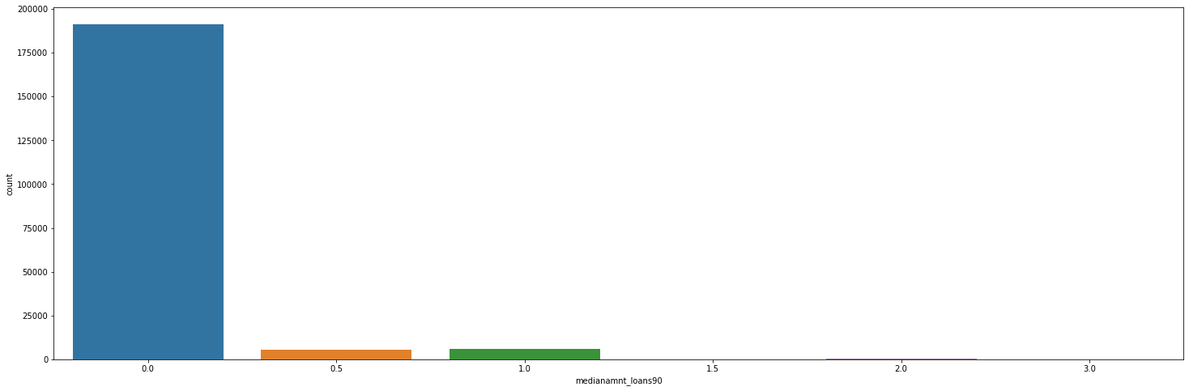

Slide 11
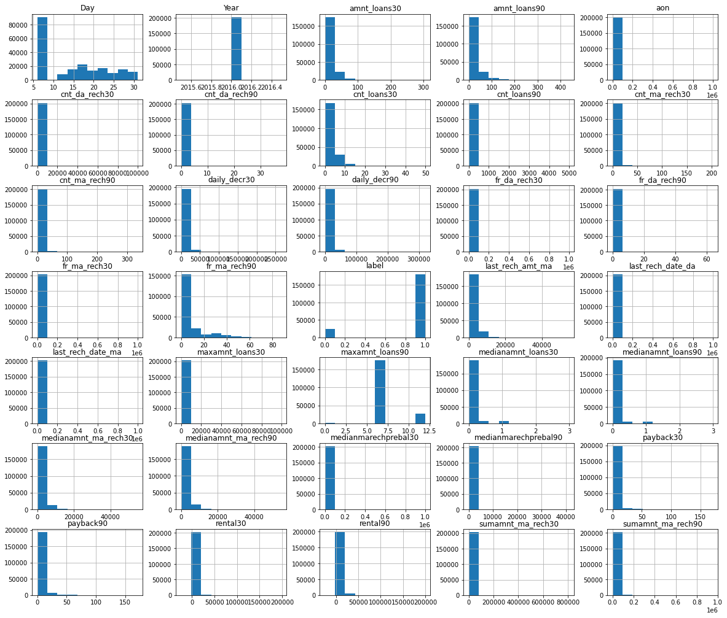
Histograms:

Slide 12
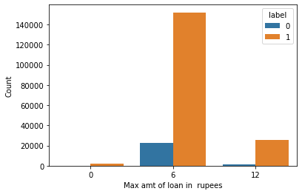
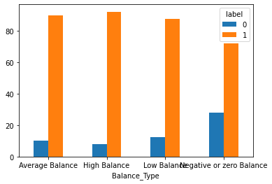
From the first plot we can see that there are more defaulter with 6 rupees loan compared to 10 rupees loan. From the second plot we can say : 1.Approx. 30% of Users having negative or zero balance are defaulters, which is very high. 2- Approx. 10% to 12% Users are defaulters which falls in the category of Average and Low balance category. 3- Users having high balance and are defaulters are very less in number

Slide 13
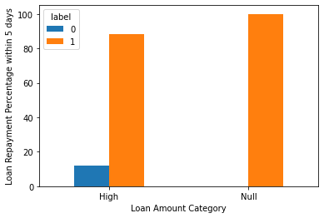
From the [plot we can say that: 1- Users who did not take any loans are non-defaulters 2- Most of the Users (i.e. 88%) who take large amount of loans comes under non defaulter category

Slide 14
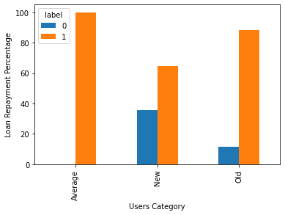
From the plot we can say that: a. 35% of the users who are defaulters are the new users b. Old Users are trusted and they are mostly non defaulters

Slide 15
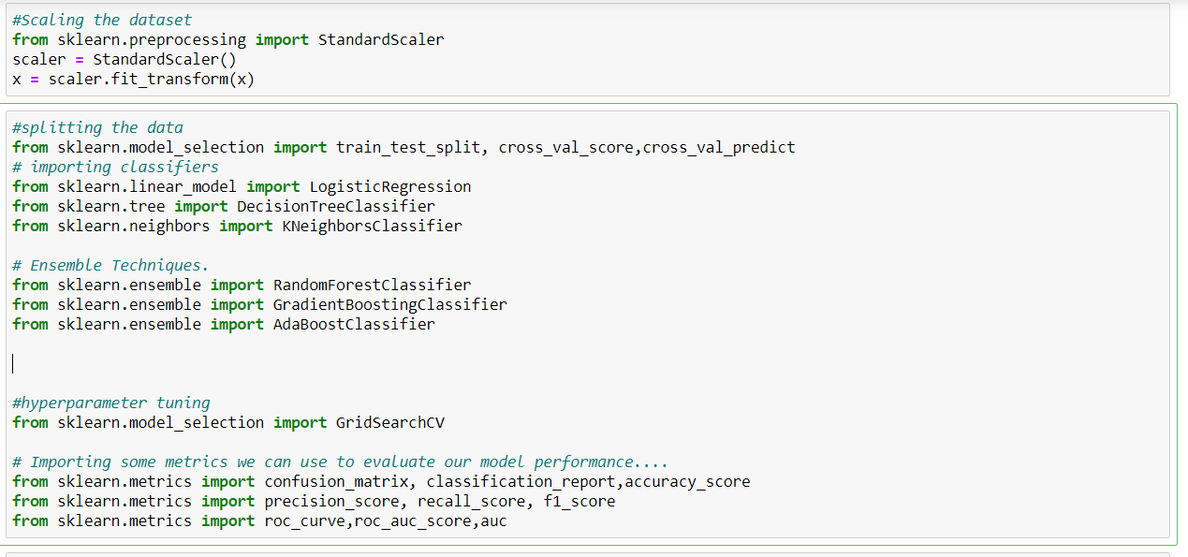
Data Pre-Processing: 1. From sklearn.preprocessing import StandardScaler 2. From sklearn.pre-processing import Label Encoder 3. from sklearn. model_selection import train_test_split, cross_val_score

Slide 16
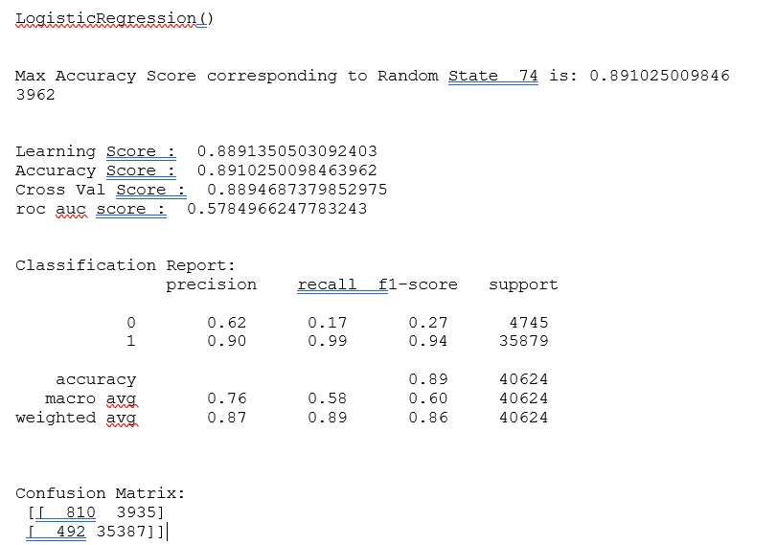
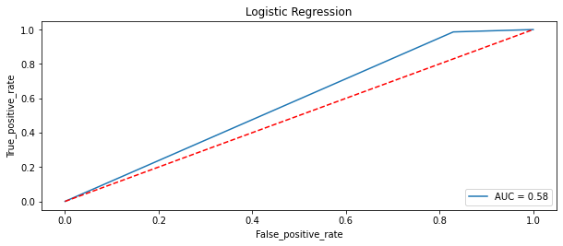
Model evaluation: we have taken 5 algorithm for our analysis. They are as follows: Logistic regression, Decision Tree Classifier, AdaBoost classifier, Gradient boost classifier, Random forest classifier there performance are as follows.

Slide 17
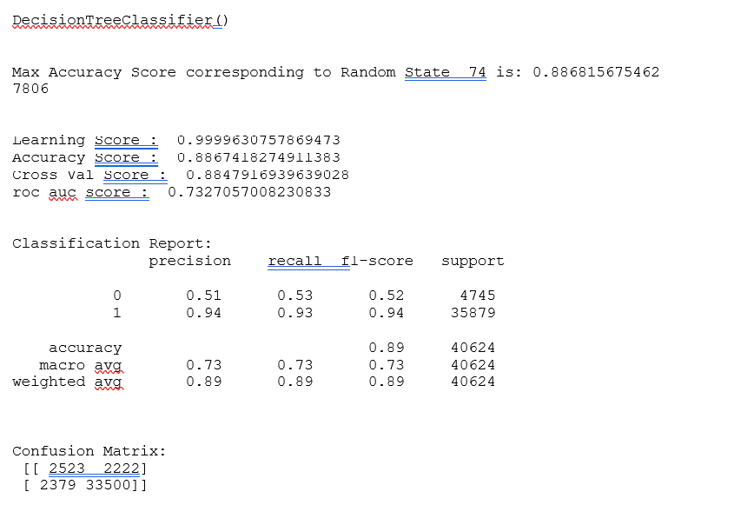
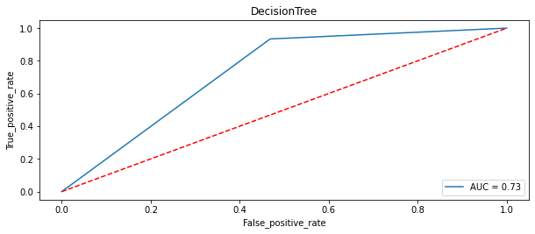

Slide 18
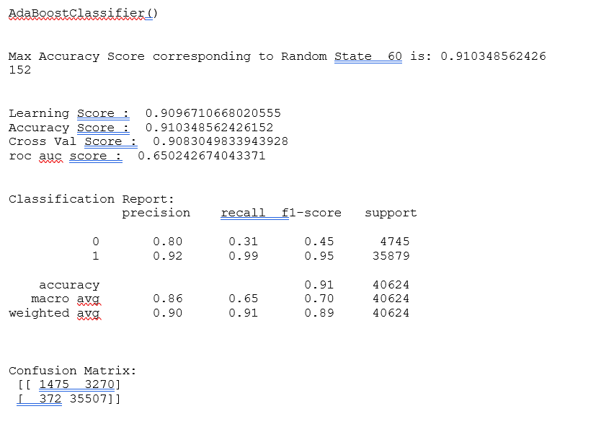
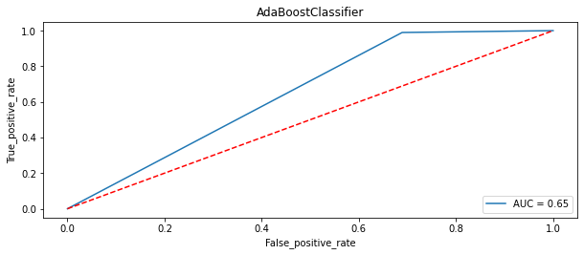

Slide 19
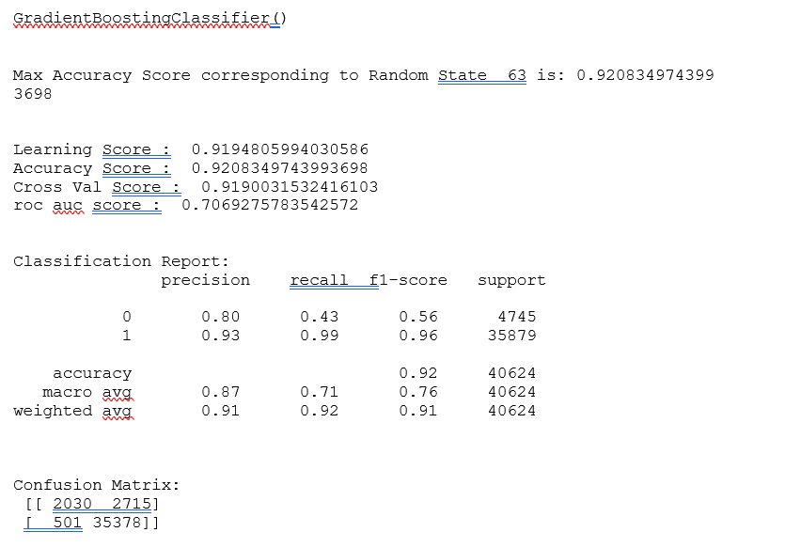
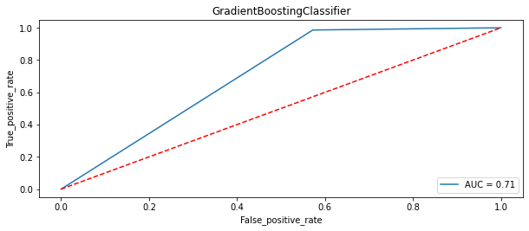

Slide 20
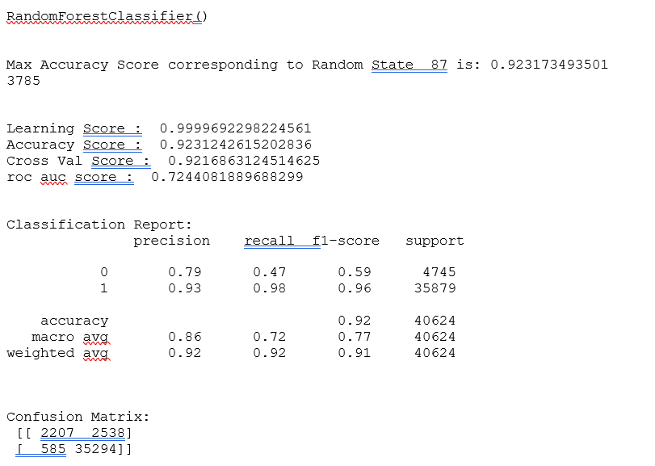
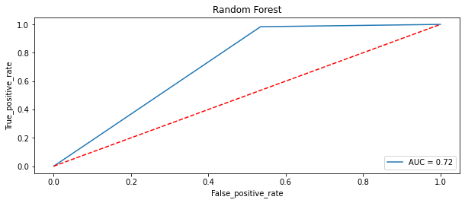

Slide 21
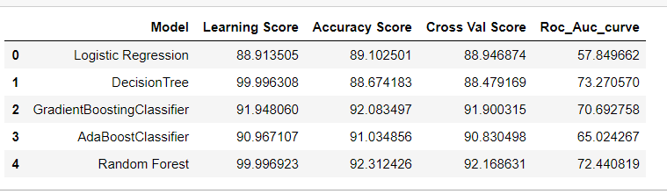
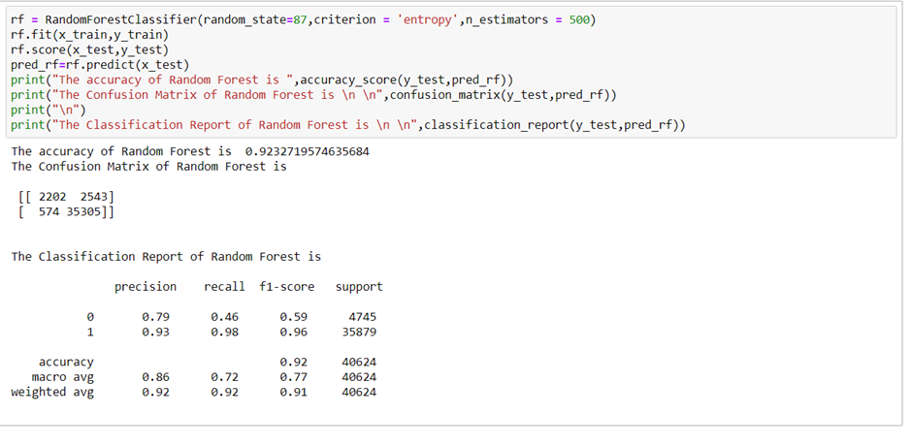
Choosing final model: From the above 5 algorithms, we have seen the best algorithm used to train the machine according to the dataset is Random Forest Classifier as all the values along the metrics were highest.

Slide 22
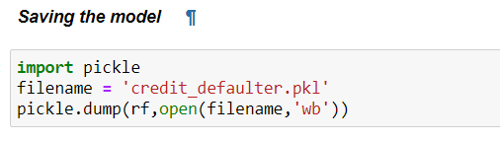
Conclusion:
The given dataset was too large. We have droped the unnecessary columns. According to data cleaning, we have checked for the null values, negative values and treated them properly and learned further that the dataset was imbalanced. We have found out the correlation of the dataset. Even, we have found high correlated data which were deleted. Many outliers were seen in the dataset. We have done visualization using two libraries like matplotlib and seaborn.
We have found that some features are right skewed in nature and we have tried to normalised them using log1p method. We have used label encoder to encode some of the categorical columns into numeric columns. We have done standard scaling to the data to simplify it. We have split the data into 80:20 ration for training and testing.
We have run different machine algorithms like logistic, random forest, ada boost, gradient boost, decision tree algorithm to find the best model and we have used metrics like accuracy score, f1 score, precision, recall, roc auc score to check performance of the algorithm.
From the above 5 algorithms, we have seen the best algorithm used to train the machine according to the dataset is Random Forest Classifier as all the values along the metrics were highest.
We have saved the final model in the form of pickle file.

